Slide 1
IOT Based Car Parking System
Made by:-Ayushi Kathait
Branch:- Computer Engineering
Class Roll No:- 07
Uni. Roll No:- 2015065

Slide 2
CONTENTS
IOT
Car parking System based on IOT
Objective
Block Diagram
Advantages
Applications
Conclusion

Slide 3

What is IOT??
The Internet Of Things(IOT) is the network of physical objects or “things” embedded with electronics, software, sensors, and network connectivity, which enables these objects to collect and exchange data.

Slide 4
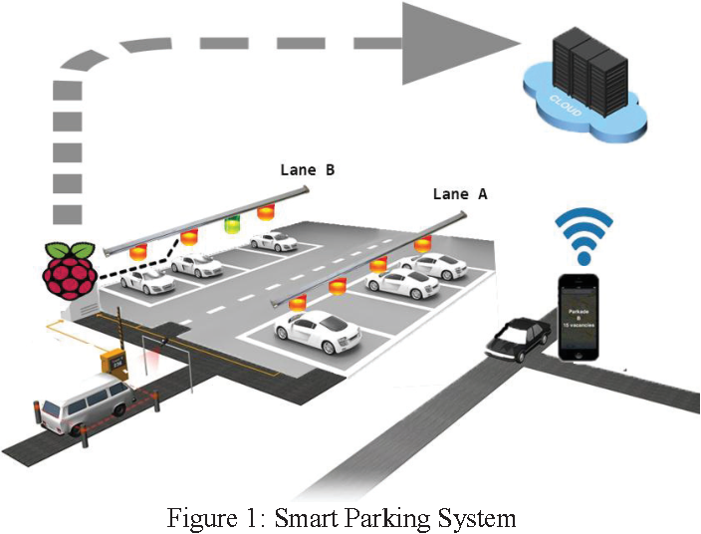
Car parking using IOT

Slide 6
Motivation
The main motivation of this project is to reduce the traffic jam that occurs in the urban areas which are caused by vehicles searching for parking. In the newspapers, we saw many articles regarding the parking problem all over India.
In India we are still using the manual vehicle parking system that why we are facing problems like wastage of time and energy finding free space across the parking surface when we need to park our car which requires a good amount of fuel. This project proposes an automated system where the parking ground will only open if it has free slots for parking.

Slide 7
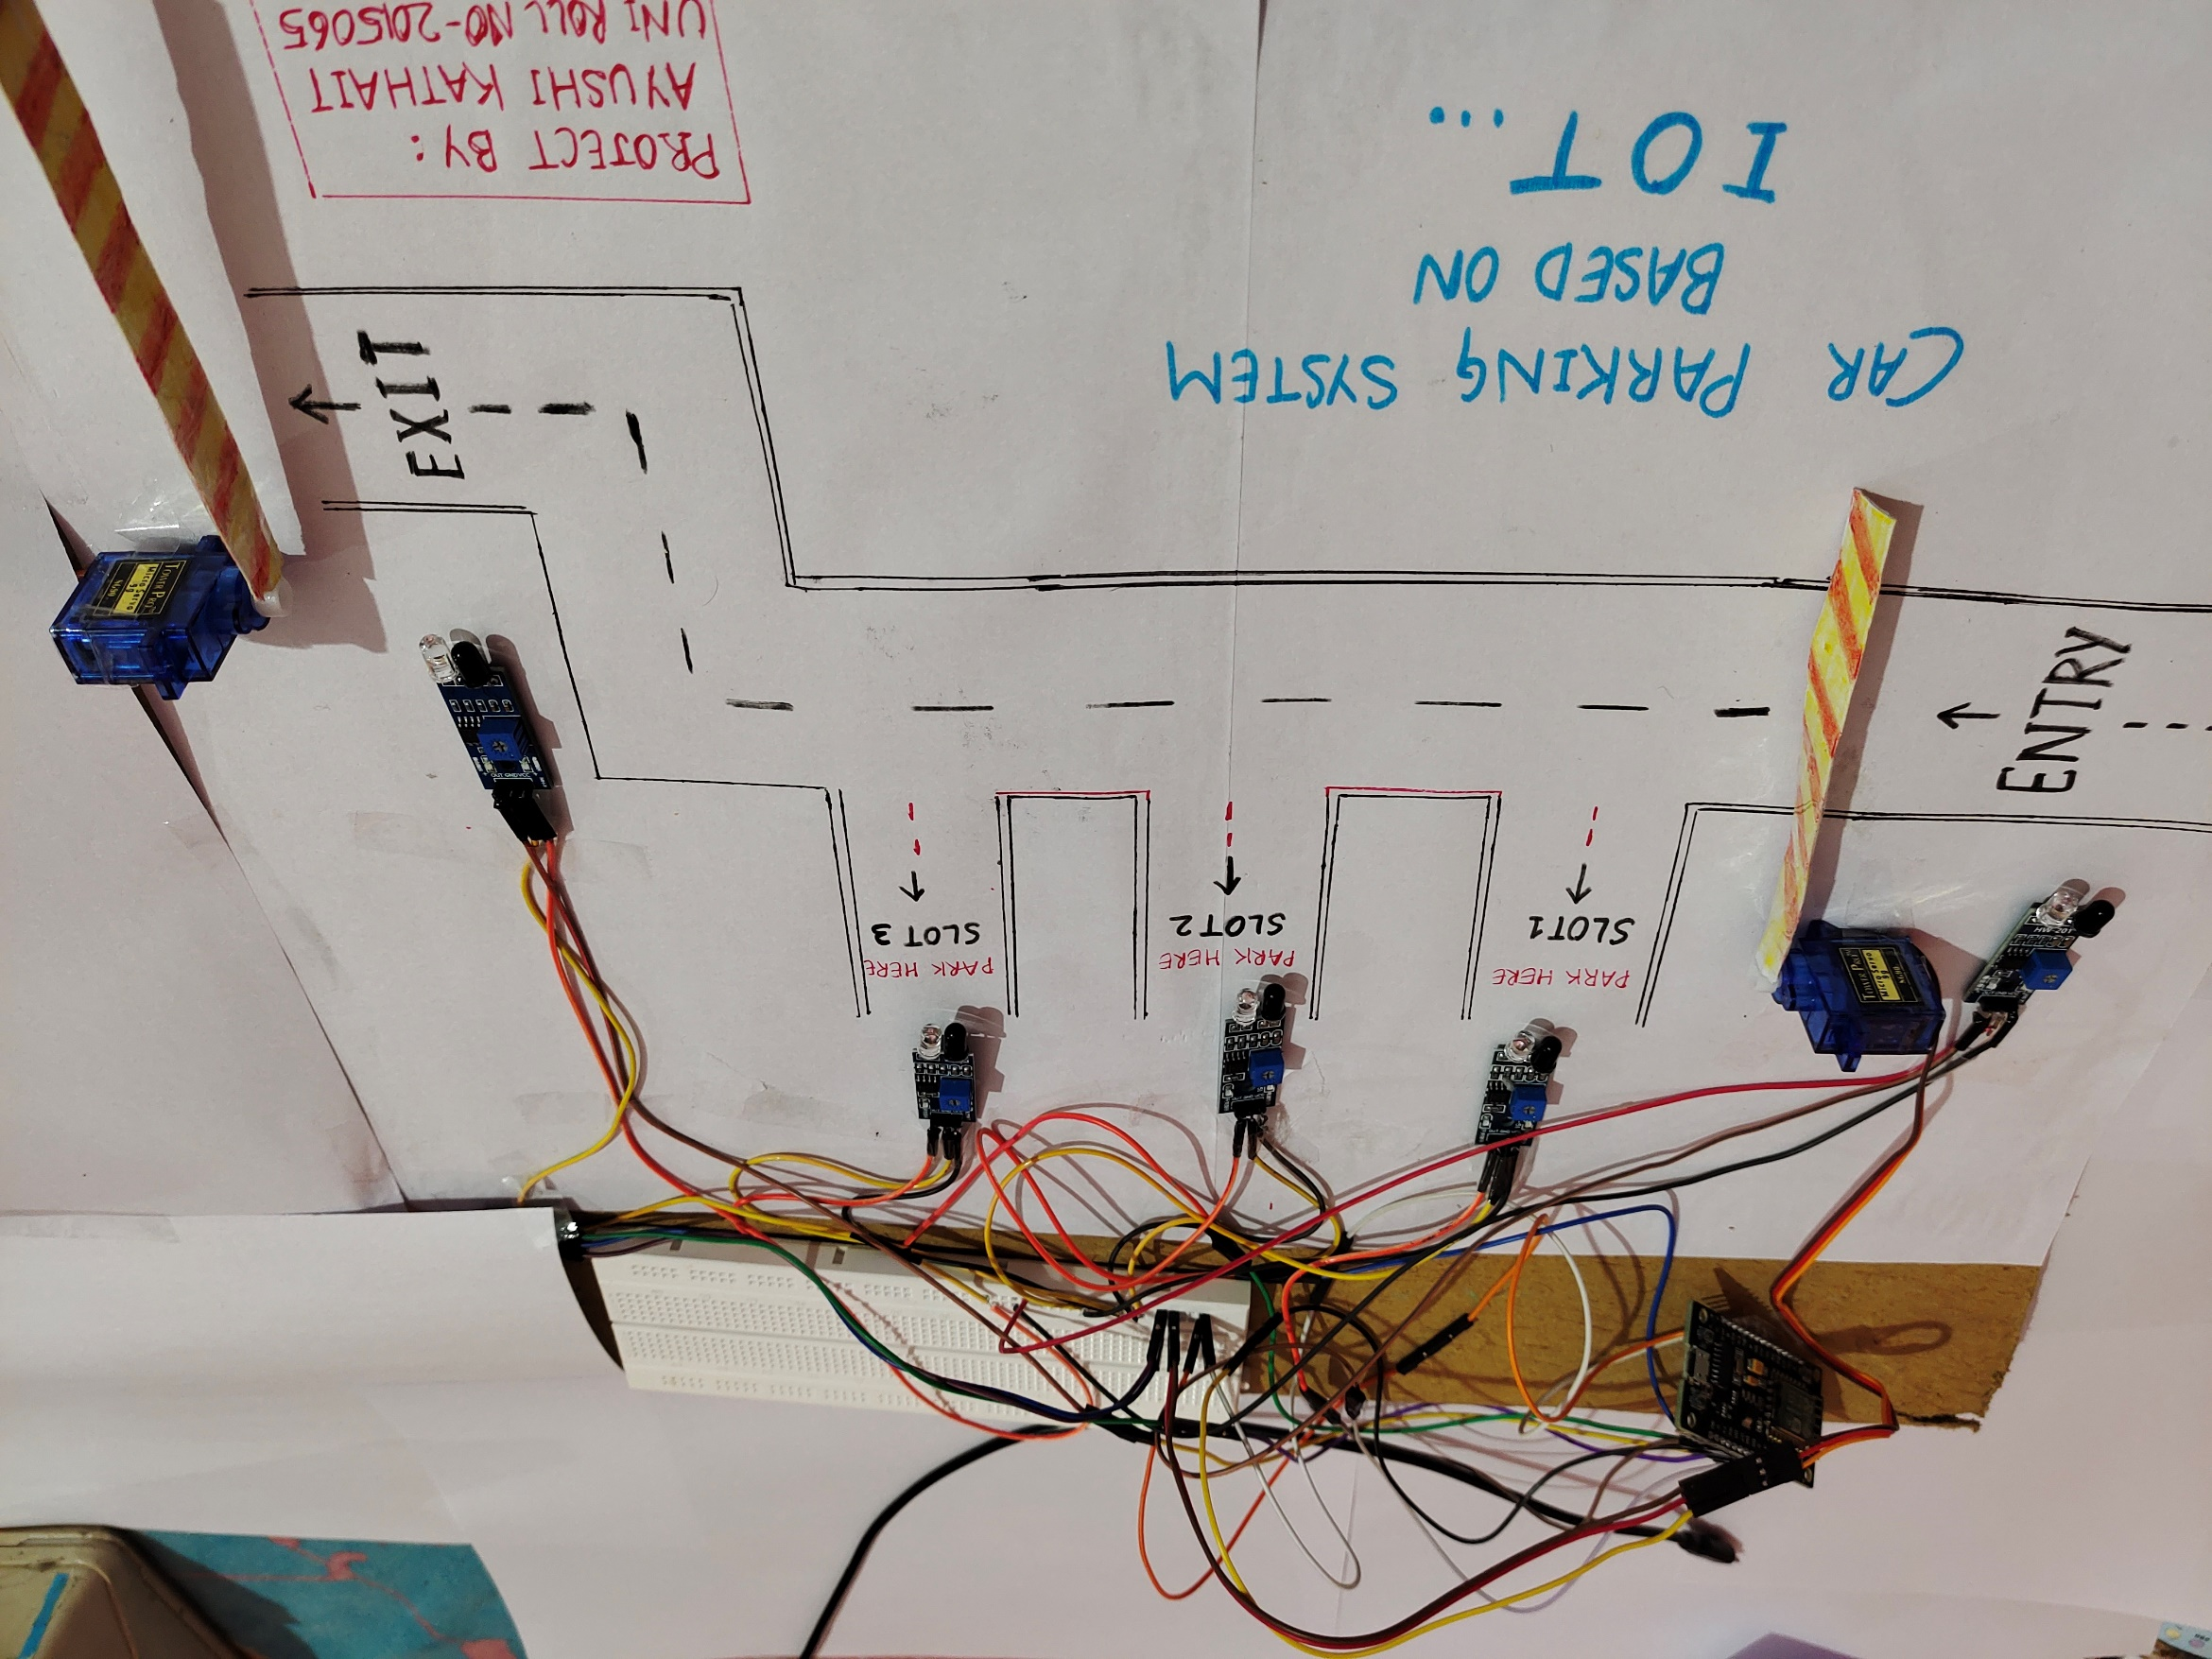

Slide 8
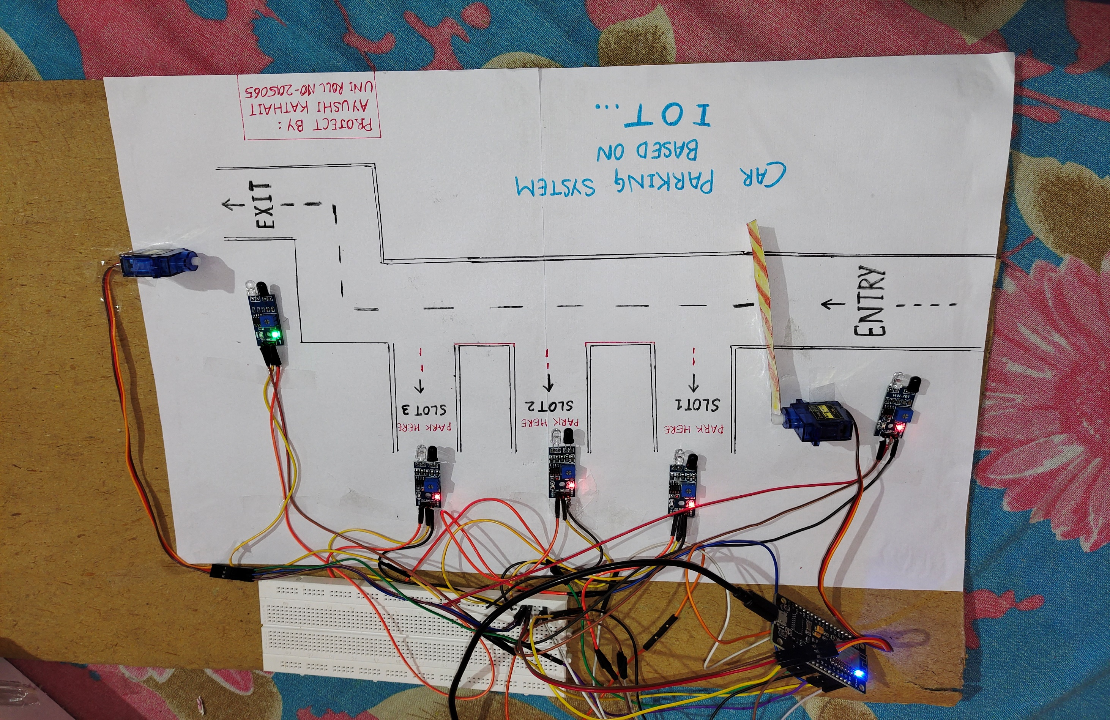

Slide 9
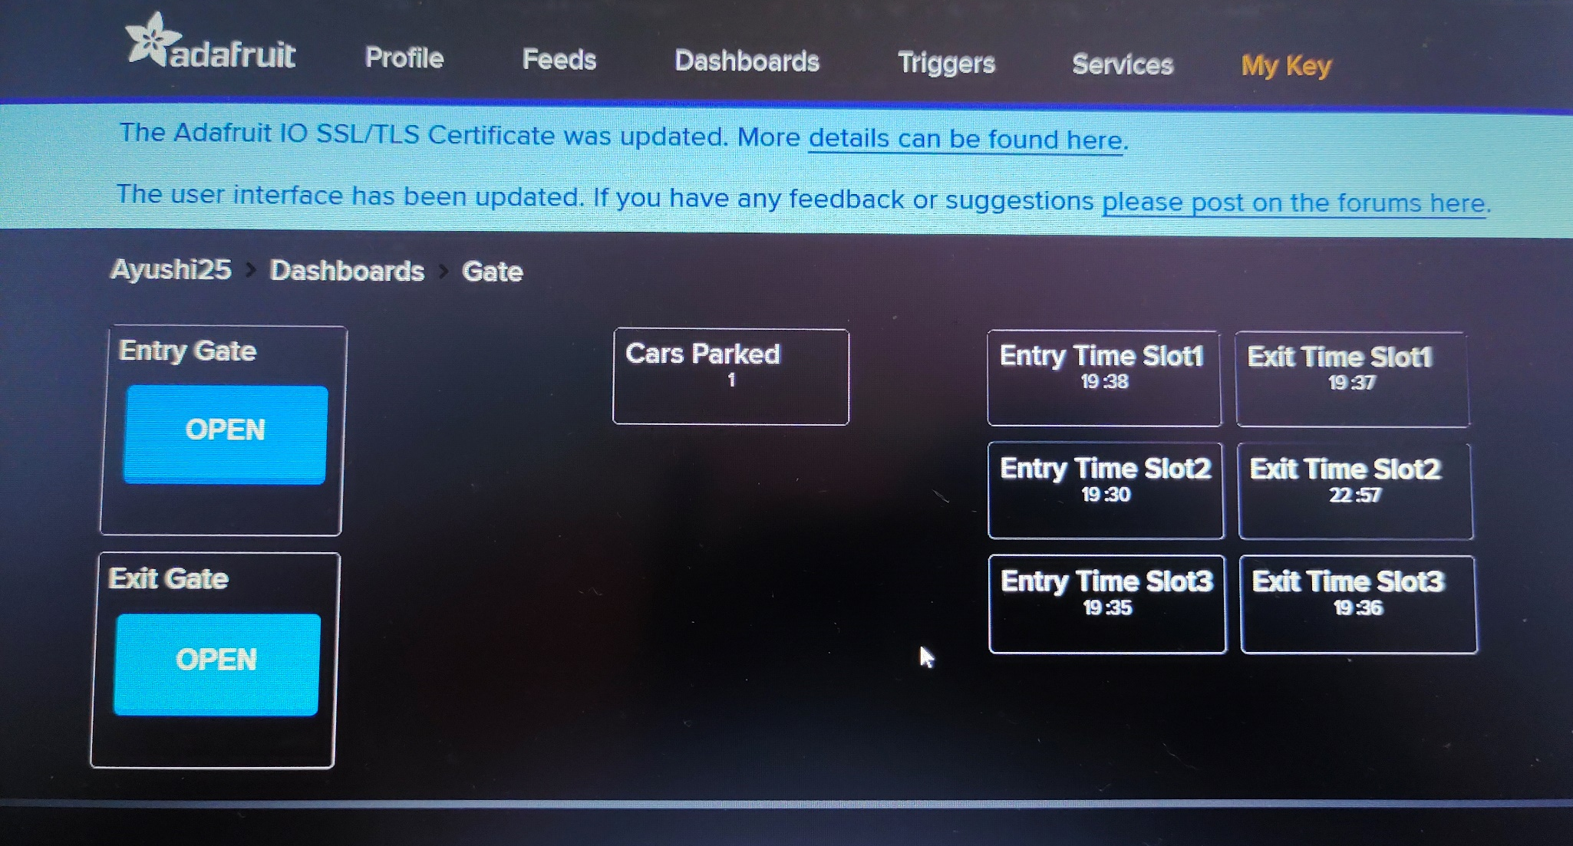

Slide 10
Objective
The main aim of this project is to reduce the efforts of people and save their precious time by providing them the details of the parking slots in a particular area.
It eliminates unnecessary travelling of vehicles around the filled parking slots and also reduces the risk of road accidents that occur due to irregular parking.

Slide 11
METHODOLOGY

Slide 12
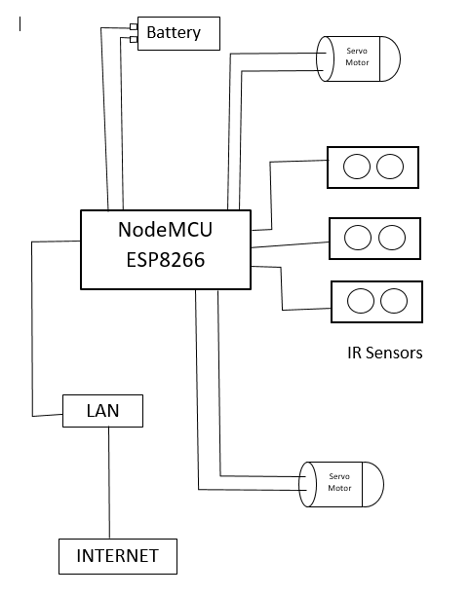
Block Diagram

Slide 13
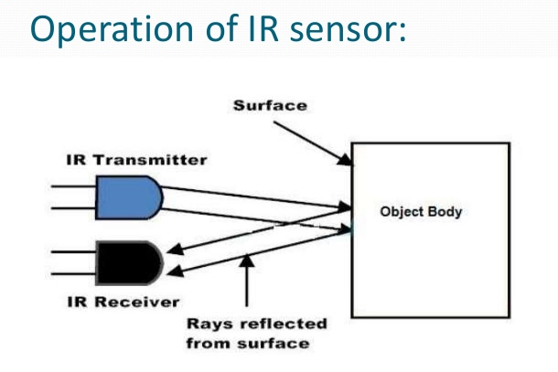
Components Used:
HARDWARE COMPONENTS:-
IR Sensors(2cm-30cm)
Servo DC Motors
Connecting Wires
NodeMCU ESP8266 Board
Breadboard

Slide 14

SOFTWARES USED:
Arduino IDE:-It is a cross-platform application that is written in functions from C and C++. It is used to write and upload programs to Arduino compatible and other development boards.
Adafruit IO:-Adafruit.io is a cloud service .We can connect to it over the Internet. It's meant primarily for storing and then retrieving data but it can do a lot more than just that!

Slide 15
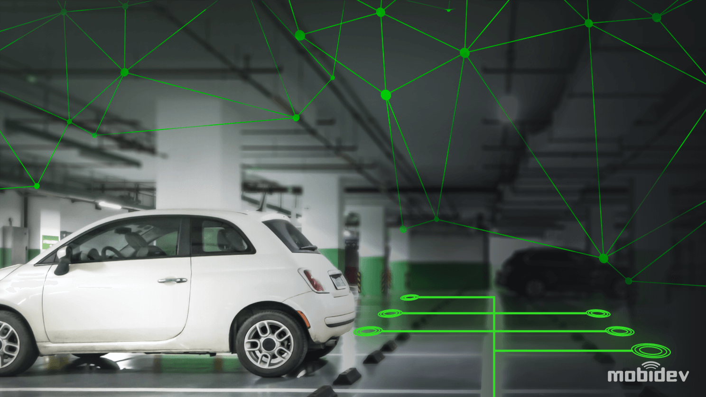
Advantages
Saves fuel
Shorter waiting time ; saves time
Reduce carbon emission
Reduces the risk of road accidents
Reduces unnecessary traffic jams caused by irregular parking

Slide 16
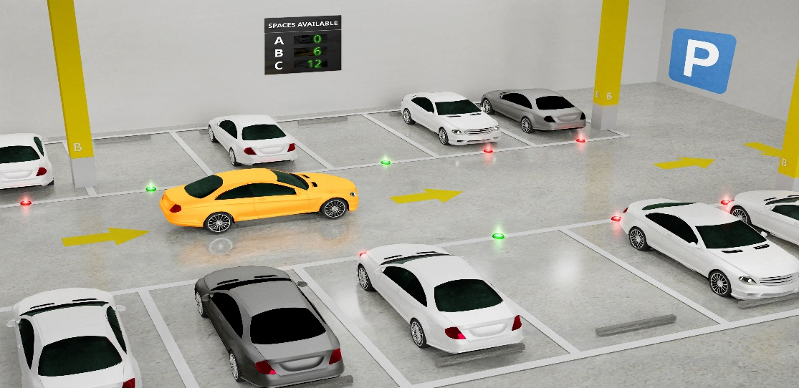
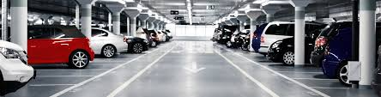
Applications
Shopping Malls
Restaurants
Theatres
Offices
Hospitals
Wedding venues

Slide 17
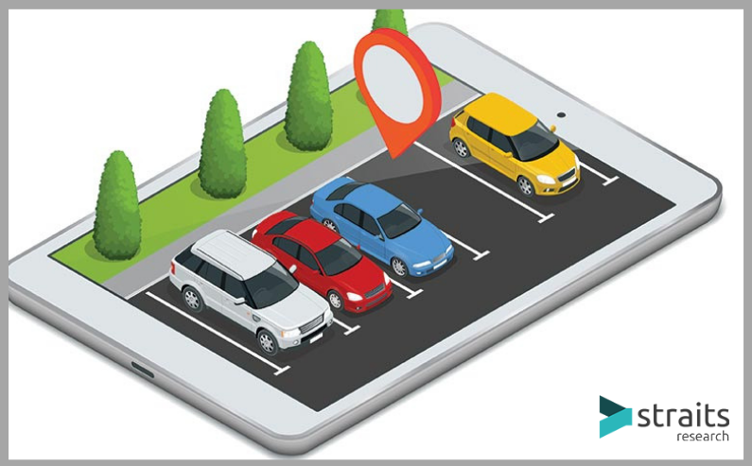
Conclusion
The system benefits of smart parking and go well beyond avoiding the wastage of time.
Developing a smart parking solutions within a city solves the pollution problem which is nowadays a major concern.

Slide 18
THANKYOU!

